Slide 1




HackOrbit 2025
Team Name:”Wathcher”

Slide 2

THEME & PROBLEM STATEMENT
TripCraft AI: Your Personal Travel Maestro
The Problem Statement: The Chaos of Modern Travel Planning
Indian tourists face a fragmented and stressful planning experience:
Information Overload: Juggling dozens of websites and apps for flights, hotels, weather, and activities is time-consuming and overwhelming.
Static Itineraries: Pre-made plans are rigid. They don't adapt to real-time changes like bad weather, sudden closures, or a simple change of interest.
Complex Budgeting: Manually tracking expenses and optimizing costs across multiple categories is a significant headache, often leading to overspending.

Slide 3
PROPOSED SOLUTION
A Unified, Multi-Agent AI System
Our solution is TripCraft AI, a smart travel agent built on a sophisticated multi-agent framework:
A Unified Platform: We provide a single point of contact for all travel needs, from initial ideation to on-the-ground assistance, eliminating the need for multiple apps.
Collaborative AI Agents: Instead of a single, monolithic AI, we use a team of specialized agents. Each agent is an expert in its domain (budgeting, weather, routing) and they work together under a central AI Orchestrator.
Hyper-Personalized Itinerary Generation: The system takes user inputs (destination, interests, budget) and crafts a geographically optimized, day-by-day plan using the power of LangChain and Llama 3.1 with an interactive user interface.
Dynamic & Adaptive Planning: The itinerary is not just a "living document.“, users will can track and be able to readjust activities using drag and drop feature and a chatbot assisting
with user queries which has your travel plan as context.

Slide 4
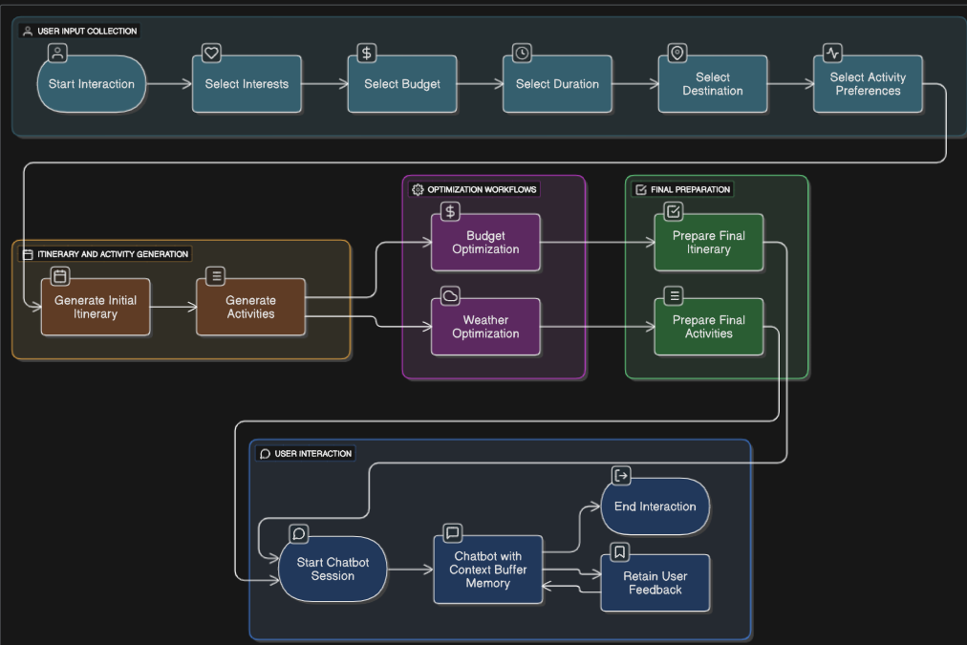
FLOWCHART
Prototype Application Architecture

Slide 5
FEATURES AND NOVELTY
1.Multi-Agent AI Orchestration :
Our system's "brain" is not one model, but a team. The Itinerary Agent plans the route, the Budget Agent optimizes costs, the Weather Agent monitors conditions, and the Tracking Agent follows your progress. This specialized approach leads to more accurate and reliable results than a single general-purpose AI.
2. Proactive Budget Intelligence for Chatbot Assistant:
Our Budget Agent does more than just track spending. It performs real-time cost analysis, suggests more affordable yet highly-rated alternatives for dining or activities, and helps you reallocate funds if you overspend in one area.
3. Deep Contextual Awareness:
Powered by ConversationBufferWindowMemory, the chatbot remembers your preferences not just in one session, but across your entire planning process. It learns that you prefer historical sites over nightlife and uses this context to refine all future suggestions.

Slide 6
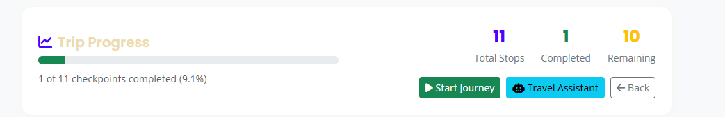
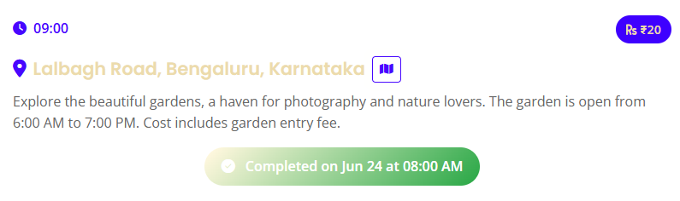
FLOWCHART / DIAGRAM
The live tracking feature will show your journey’s summary alongside a Trip progress bar which will show the activities completed so far as shown in the in the UI.
(the actual UI might be different ,this is just for demonstration purpose)
The Itinerary card will show appropriate time to visit with cost estimation and apart from that a bonus feature i.e. a tip for a particular activity ensuring the destination awareness for tourists.

Slide 7
AI TECHSTACK
We've made specific technology choices to build a superior solution:
Fast Inference with Groq:
User interaction needs to be real-time. By leveraging the Groq API with Llama 3.1 8B, we achieve near-instantaneous responses. This makes the conversational experience smooth and natural, unlike slower, traditional API calls.
Structured & Reliable Outputs with LangChain:
A key failure of many AI bots is unpredictable or malformed output. We use LangChain's structured output schemas to force the LLM to generate clean, predictable JSON data every time, ensuring our application remains robust and error-free.
Specialized Agents > Monolithic Model:
Our multi-agent architecture is inherently more powerful. A monolithic model trying to handle weather, budget, and routing simultaneously is inefficient. Our specialized agents are fine-tuned for one task, leading to higher accuracy and making the system easier to debug and upgrade.

Slide 8
DRAWBACK AND SHOWSTOPPERS
Potential Drawbacks:
High Dependency on API Quality: Our system's real-time capabilities are only as good as our third-party APIs (OpenWeatherMap, Nominatim). An API outage or inaccurate data could temporarily degrade our service quality.
The 'Cold Start' Problem: For a brand-new user, the system has no historical data, making deep personalization difficult initially. The agent becomes significantly more powerful after the first few interactions.
Potential Showstoppers (Critical Risks):
Scalability & API Costs: The high performance of the Groq API and other services comes at a cost. A successful scaling strategy must include robust cost management and optimization to ensure the business model remains viable as the user base grows.
User Trust and Adoption: A single critical failure (e.g., a major routing error or a missed flight suggestion) can irrevocably break a user's trust. The system must be exceptionally reliable from day one to encourage adoption and build a loyal user base. Our entire development process is centered on building this trust through accuracy and proactive help.

Slide 9
TEAM NAME:”Watcher”
Vaibhav Anuragi
(8962735182)
(vaibhavanuragi02@gmail.com)
Kalindi Mishra
(8989475670)
(kalindimishra2626@gmail.com)

Slide 10
Thank you

